Slide 1
Lecture 26
Referencing (cont’d)

Slide 2
Referencing
Harvard Referencing
In-text citations
Reference List

Slide 3
WORKS CITED
BOOK IN A SERIES:
Bloom, Harold, Modern Critical Views ed. André Malraux. New York: Chelsea House, 1988. Print. .
ARTICLE IN A JOURNAL:
Article retrieved in print/paper format
Ferrer, Ada. "Cuba 1898: Rethinking Race, Nation, and Empire." Radical
History Review 73 (1999): 22-49. Print.
Article retrieved on the Web
Sehmby, Dalbir S. "Wrestling and Popular Culture." CCLWeb: Comparative Literature and Culture 4.1 (2002): n. pag. Web. 29 Mar. 2009.

Slide 4
WORKS CITED
Article retrieved in a library database
Brennan, Katherine Stern. "Culture in the Cities: Provincial Academies during the Early Years of Louis XIV's Reign." Canadian Journal of
History 38.1 (2003): 19-42. CBCA Complete. Web. 29 Mar. 2004.
ARTICLE IN A NEWSPAPER OR MAGAZINE:
Semenak, Susan. "Feeling Right at Home: Government Residence
Eschews Traditional Rules." Montreal Gazette 28 Dec. 1995, Final Ed.: A4. Print.
AN ENTIRE WEB SITE:
Linder, Douglas O. Famous Trials. Univ. of Missouri Kansas-City Law
School, 2009. Web. 29 Apr. 2009.

Slide 5
WORKS CITED
A PAGE ON A WEB SITE:
An entry for a non-periodical item found on the Web contains the following:
Last name, First name. "Document title if available." Title of the overall Web site. Version or edition if available. Publisher or N.p. to designate no publisher, publication date or n.d. to mean no date. Web. Date of access.
"Joyce Wieland." Celebrating Women's Achievements: Women Artists in Canada. National Library of Canada, 2000. Web. 29 Mar. 2004.
A REVIEW:
Kirn, Walter. "The Wages of Righteousness." Rev. of Cloudsplitter, by Russell Banks. New York Times Book Review 22 Feb. 1998: 9. Print.

Slide 6
WORKS CITED
TELEVISION OR RADIO PROGRAM:
"Scandal of the Century." Narr. Linden MacIntyre. The Fifth Estate. CBC Television. 23 Jan. 2002. Television.
SOUND RECORDING:
Ellington, Duke. "Black and Tan Fantasy." Music is My Mistress. Musicmasters, 1989. CD.
FILM, VIDEORECORDING OR DVD:
The Shining. Dir. Stanley Kubrick. Perf. Jack Nicholson, Shelley Duvall. Warner Bros., 1980. Videocassette.

Slide 7
WORKS CITED
MUSICAL COMPOSITION, PUBLISHED SCORE:
Beethoven, Ludwig van. Symphony no. 4 in B-flat major, op. 60. Mineola, NY: Dover, 2001. Print.
WORK OF ART, PHOTOGRAPHED, IN A BOOK:
Cassatt, Mary. Mother and Child. 1890. Wichita Art Museum, Wichita. American Painting: 1560-1913. By John Pearce. New York: McGraw, 1964. Slide 22.

Slide 8
What is the Vancouver Referencing Technique?
A uniform set of requirements for bibliographic references.
a "numbered" style
follows rules established by the International Committee of Medical Journal Editors
also known as: Uniform Requirements for Manuscripts Submitted to Biomedical Journals.

Slide 9
About Vancouver
Small group of editors met in Vancouver, Canada in 1978. Known as Vancouver group
Established guidelines for format of manuscripts submitted to their journals
Guidelines developed by the NLM, first published in 1979
Group expanded to International Committee of Medical Journal Editors (ICMJE)
ICMJE broadened concerns to include ethical principles related to publication in biomedical journals

Slide 10
About Vancouver (2)
Revised on a regular basis – most recent revision 2005
ICMJE still operates as a small working group
Most biomedical and IT-related journals today use Vancouver
Vancouver -accredited journals are encouraged to state the use of the technique in their Instructions to Authors

Slide 11
In-text citing
A number is allocated to a source in the order in which it is cited in the text
If the source is referred to again, the same number is used.
Example:...as one author has put it "the darkest days were still ahead" [1]: which is well documented in the literature. [2-5] This proves that "the darkest days were still ahead". [1]

Slide 12
References
References are listed in numerical order in the Reference List at the end of the paper
Example:
1. Smith SD, Jones, AD. Organ donation. N Engl J Med. 2001;657:230-5.
2. Brown JG. Asphyxiation. Med J Aust. 2003; 432:120-4.

Slide 13
Essential Elements for referencing books Author Title Edition Place of Publication Publisher Date (year)

Slide 14
Examples
Personal Author:
Adam RD, Victor M. Principles of Neurology. 5th ed. New York: McGraw-Hill, 1993.
Editor(s) or Compiler(s):
Diener HC, Wilkinson M, editors. Drug-induced headache. New York: Springer-Verlag, 1988.
Organization as author:
Virginia Law Foundation. The Medical and legal implications of AIDS. Charlottesville: The Foundation, 1987.

Slide 15
Examples
Chapter in a book:
Wynick D, Bloom SR. Islet cell tumors. In: Grossman A. Clinical Endocrinology. Oxford: Blackwells Scientific Publications, 1992: 502-511.
Conference Proceedings:
Preston D, editor. Computers in Clinical Dentistry. Proceedings of the first International Conference on Computers in Clinical Dentistry; 1991 Sept 26-29: Houston. Chicago: Quintessence, 1993.
Monograph in electronic format:
CDI, Clinical dermatology illustrated [monograph on CD-Rom]. Reeves JRT, Maibach H. CMEA Multimedia Group, Producers. 2nd ed. Version 2.0. San Diego: CMEA; 1995.

Slide 16
Essential Elements for referencing journals Author Title of Article Journal Title Date Volume number Issue number Page numbers

Slide 17
Examples
(Titles of Journals should be abbreviated according to Index Medicus)
Standard Journal Article: (list all authors, but if there are more than six, only list the first six followed by “et al”)
Burks RT, Morgan J. Anatomy of the lateral ankle ligaments. Am J Sports Med 1994 Jan-Feb; 22(1): 72-77.
Organization as author:
NIH Technology Assessment Workshop Panel. The Persian Gulf Experience and Health. JAMA 1994; 272: 391-395.
No author given:
Coffee drinking and cancer of the pancreas [editorial] BMJ 1981; 283:628.

Slide 18
Examples
Volume with supplement
Leff J. Working with the families of schizophrenic patients. Br J Psychiatry 1994; 164 Suppl 23: 71-76.
Issue with supplement:
Hirschfeld RMA, Holzer CE. Depressive personality disorders: clinical implications. J Clin Psychiat 1994 Apr; 55 (4Suppl): 10-17.
Journal article in Electronic format:
Morse SS. Factors in the emergence of infectious diseases. Emerg Infect Dis [serial online] 1995 Jan-Mar [cited 1996 Jun 5]; 1(1): [24 screens]. Available from: URL: http://www.cdcgov/ncidod/EID/eid.htm

Slide 19
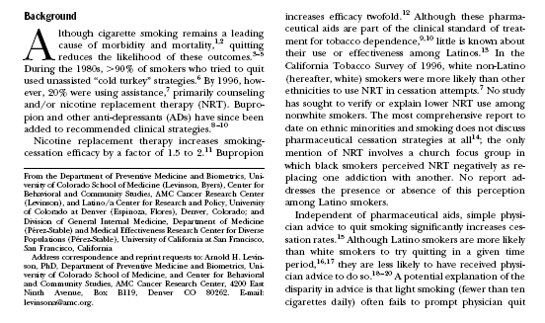

Slide 20
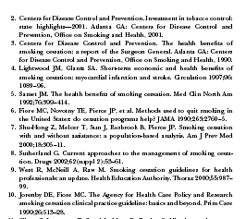

Slide 21
Summary
Referencing
Harvard Style
Vancouver Style
Examples

